Slide 1
Python course 3
Function

Slide 2
Use function
range(5)
max([1,2,3]), min([1,2,3])
list(range(4)), str(123), int(5.5)

Slide 3
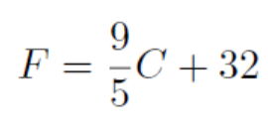

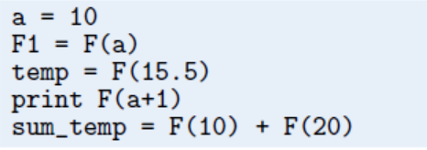
Define a function
Celsius-Fahrenheit Conversion

Slide 4
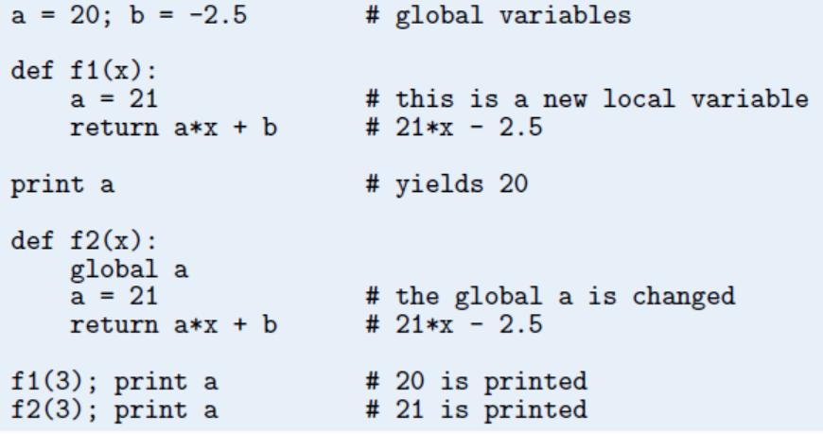
local vs global variables

Slide 5
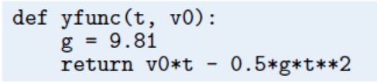
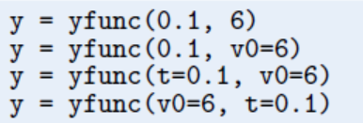
Multiple Arguments

Slide 6
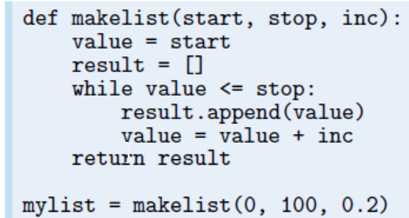

Slide 7
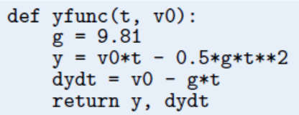
Multiple Return Values

Slide 8
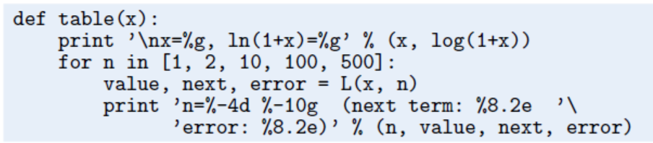
Functions with No Return Values

Slide 9
Keyword Arguments
somefunc(’Hello’, [1,2])
somefunc(’Hello’, [1,2], kwarg1=’Hi’)
somefunc(’Hello’, [1,2], kwarg2=’Hi’)
somefunc(’Hello’, [1,2], kwarg2=’Hi’, kwarg1=6)

Slide 10
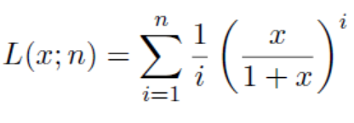

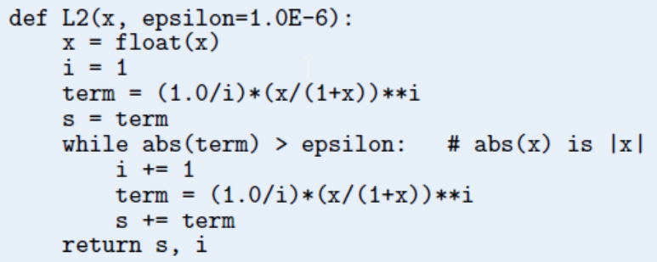
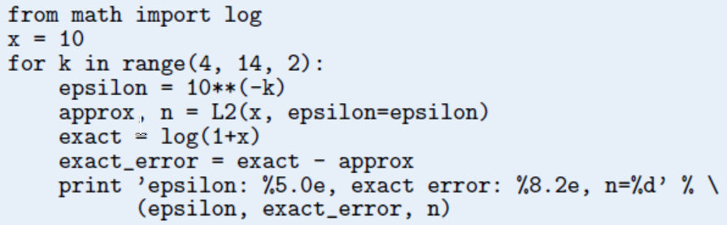

Slide 11
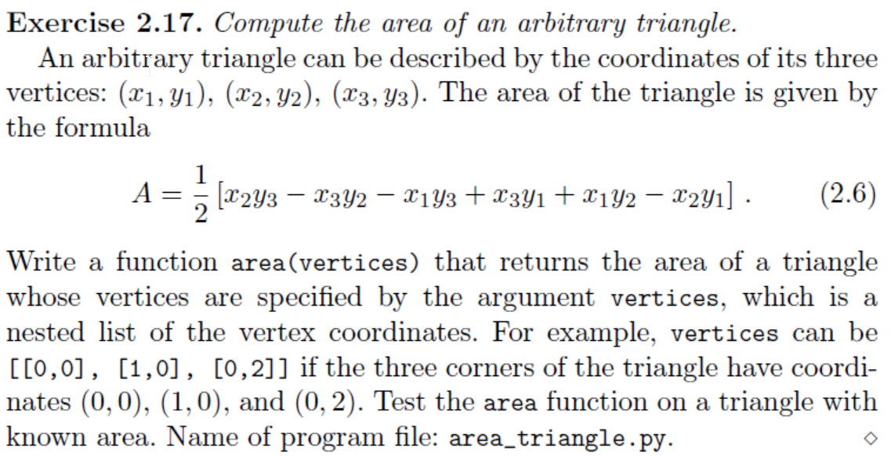

Slide 12
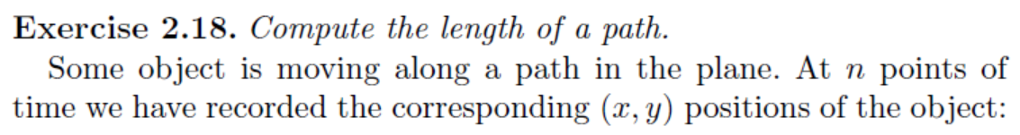
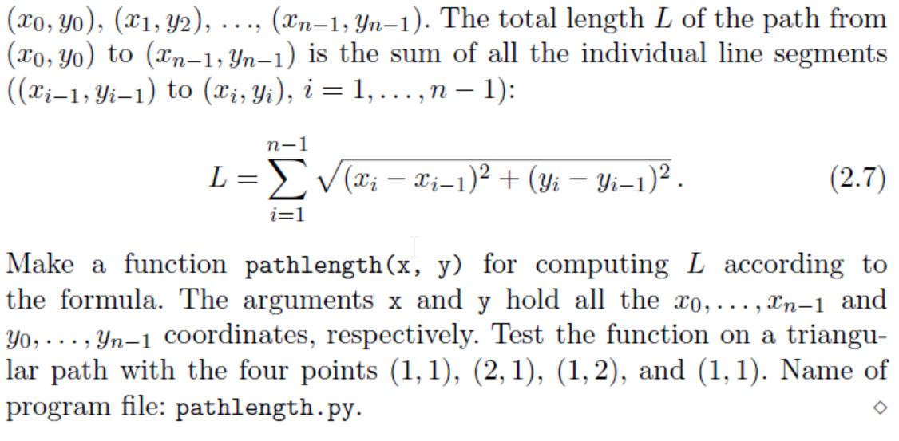

Slide 13
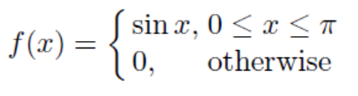
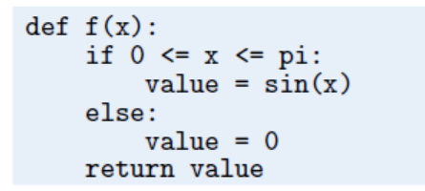

Slide 14
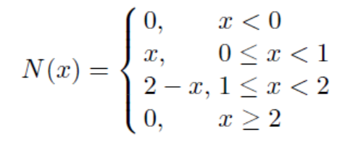
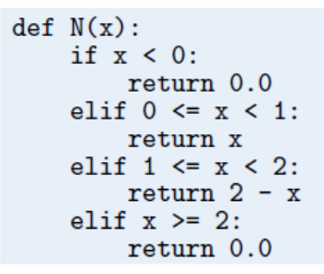

Slide 15
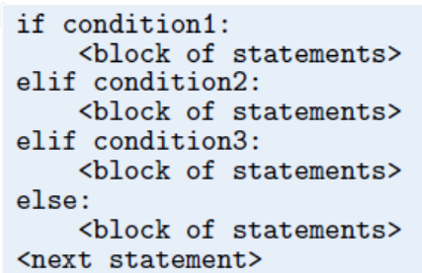

Slide 16
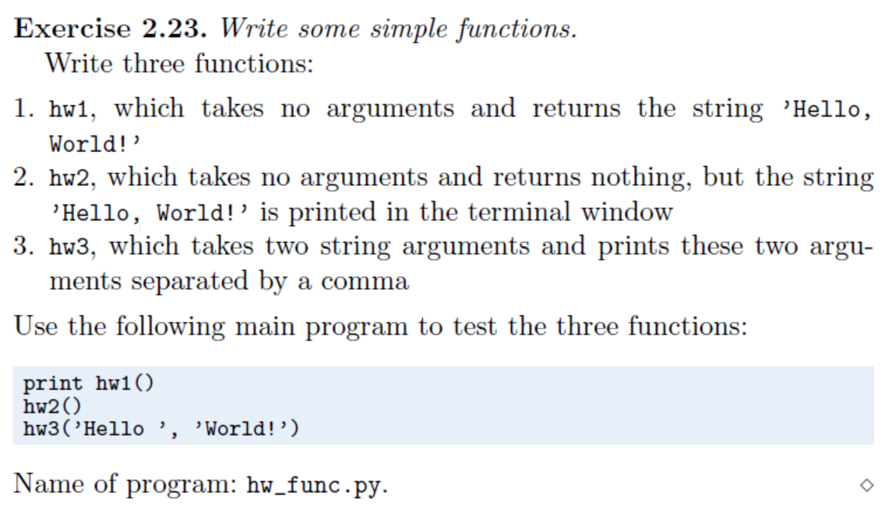

Slide 17
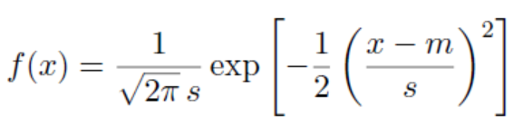
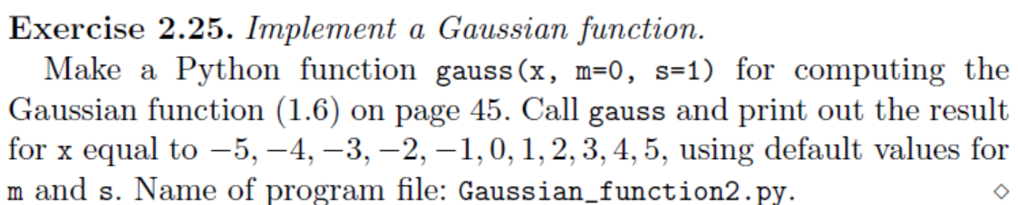
0. 把x和函数值分别保存到一个list
1 .Plot this function by matplotlib
2. 调用m=1， s=2时的函数并且plot出来
3. map() 函数

Slide 18
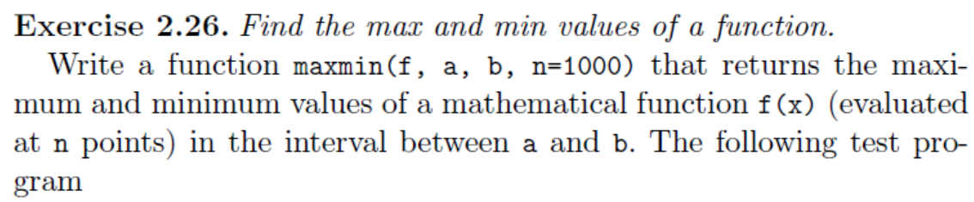
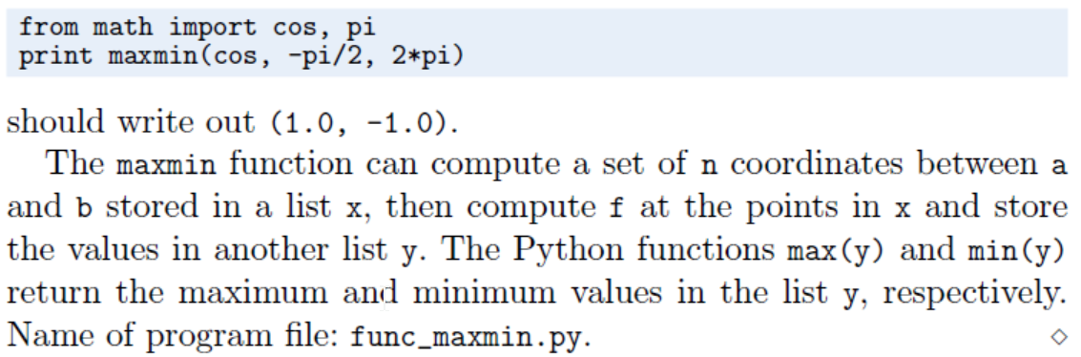

Slide 19
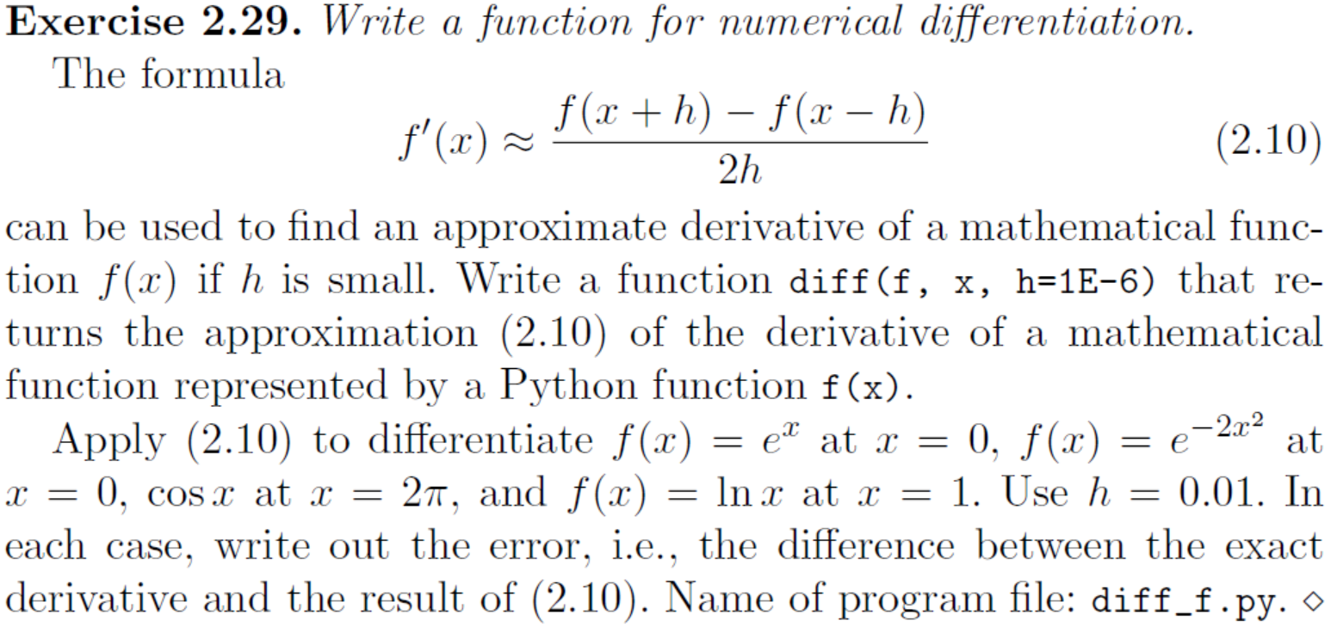

Slide 20
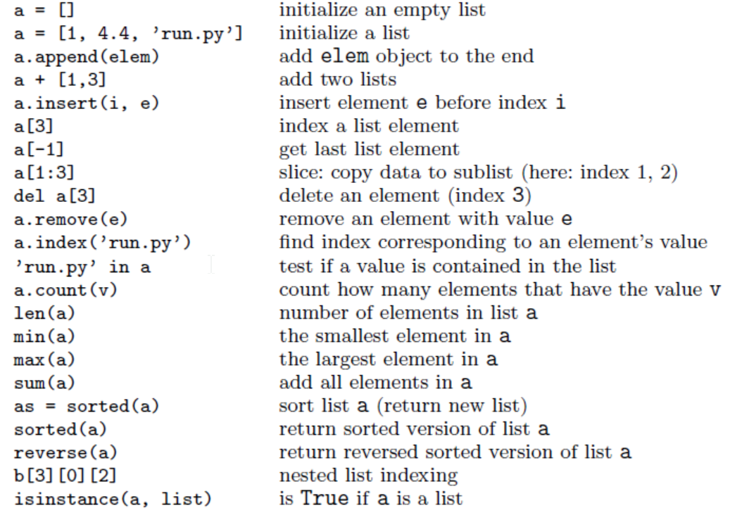

Slide 21
Next Class
字符串操作
文件读写

